Slide 1
Movies part 2
Barb Ericson
Georgia Institute of Technology
April 2006

Slide 2
Learning Goals
Media Goals
  Generate a tickertape text movie
  How to move more than one drawn object in a movie
Computer Science Goal
  Use a loop
  Modify and extend an existing method

Slide 3

Generating a Tickertape Movie
You can animate text by using drawString
  At different locations over time on a blank picture
  drawString("text to draw",baseX,baseY);
The method drawString will automatically clip the string if it goes off the edge of the picture
Click in the rectangle
to see the
tickertape movie
Notes:
This mpeg file was created with ImageMagick using
convert –adjoin –border 1 –bordercolor black frame*.jpg frame.mpeg

Slide 4
Code for Tickertape Movie
public void makeTickerTapeMovie(String directory,
String message)
{
int framesPerSec = 30;
Picture p = null;
Graphics g = null;
FrameSequencer frameSequencer =
new FrameSequencer(directory);
Font font = new Font("Arial",Font.BOLD,24);
// loop for 2 seconds of animation
for (int i = 0; i < framesPerSec * 2; i++)
{

Slide 5
Code for Tickertape Movie - Cont
// draw the string
p = new Picture(300,100);
g = p.getGraphics();
g.setColor(Color.BLACK);
g.setFont(font);
g.drawString(message,300 - (i * 10), 50);
// add frame to sequencer
frameSequencer.addFrame(p);
}
// play the movie
frameSequencer.play(framesPerSec);
}

Slide 6
Main for Testing
public static void main(String[] args)
{
MovieMaker movieMaker = new MovieMaker();
String dir =
"c:/intro-prog-java/movies/tickertape/";
movieMaker.makeTickerTapeMovie(dir,
"Buy more widgets");
}
Notes:
Change the directory if you wish to store the frames in another location.

Slide 7
Exercise
Create a new method in MovieMaker
Show text starting at the bottom of a picture and moving to the top
  You can even change the font size as it moves
Or you can move the text from top left to bottom right

Slide 8
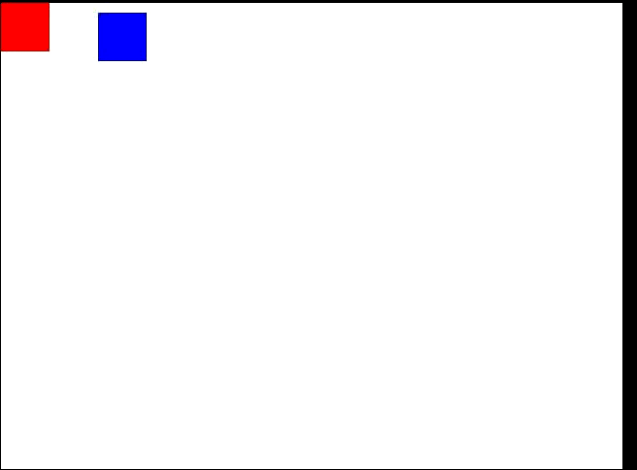
Moving Two Objects
You can have more than one object moving in your movie
  Just draw more than one object in a different location in each frame
  Here we use the same red rectangle from the previous movie
  But add a blue rectangle moving in a circular way
Notes:
This mpeg file was created with ImageMagick using
convert –adjoin –border 1 –bordercolor black frame*.jpg frame.mpeg
Click on the movie to play it.

Slide 9
Code for Two Rectangle Movie
public void makeTwoRectangleMovie(String directory)
{
int framesPerSec = 30;
Picture p = null;
Graphics g = null;
FrameSequencer frameSequencer =
new FrameSequencer(directory);
// loop through the first second
for (int i = 0; i < framesPerSec; i++)
{

Slide 10
Code for Two Rectangle Movie - Cont
// draw a filled rectangle
p = new Picture(640,480);
g = p.getGraphics();
g.setColor(Color.RED);
g.fillRect(i * 10, i * 5, 50,50);
g.setColor(Color.BLUE);
g.fillRect(100 + (int) (10 * Math.sin(i)),
4 * i + (int) (10 * Math.cos(i)),
50,50);
// add frame to sequencer
frameSequencer.addFrame(p);
}
// play the movie
frameSequencer.play(framesPerSec);
}

Slide 11
Main for Testing
public static void main(String[] args)
{
MovieMaker movieMaker = new MovieMaker();
String dir =
"c:/intro-prog-java/movies/rectangle2/";
movieMaker.makeTwoRectangleMovie(dir);
}
Notes:
Change the directory if you wish to store the frames in another location.

Slide 12
Exercise
Create a new method in MovieMaker
Move two filled rectangles some random amount in x and y (< 5 pixels) each step in the animation
  Use a random number generator (java.util.Random) to generate the random amounts
  Make sure that the rectangles don't leave the picture

Slide 13
Summary
You can move from text from right to left
  Start at the right side
  Subtract an increasing amount each time through the loop
g.drawString(message,300 - (i * 10), 50);
You can move more than one object at the same time
  Modify how you specify the current location of the object

